Slide 1

Hands-on Session on Full Stack Development
SUNITA SHAKUNIYA
8/10/2024

Slide 2
Agenda
Introduction
Tech Stack
Future Trends and Opportunities
Hands-on session
Project Demo of React/Django/Flask
Important Links and Resources

Slide 3

Introduction
https://github.com/Sunita-Shakuniya/data/blob/main/Untitled%20design%20(8).png?raw=true

Slide 4
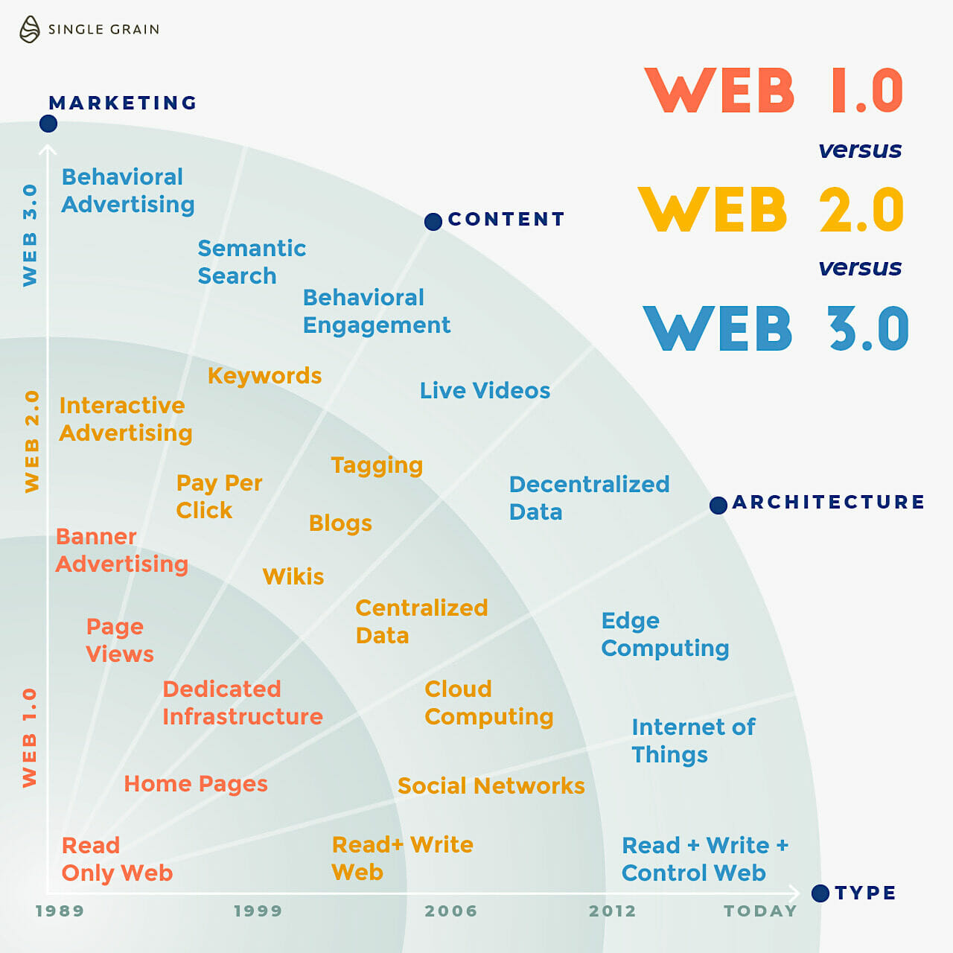
Evaluation of Web
Web 1.0 – Static Pages
Web 2.0 – Dynamic Content, Social Interaction
Web 3.0 – Semantic Web, AI, Blockchain Integration
Progressive Web Apps (PWAs)

Slide 5

Technology Focus
Frontend Developer
Backend Developer
Full Stack Developer
https://www.tops-int.com/blog/roadmap-to-become-a-full-stack-developer

Slide 6

Trends and Opportunities
Single Page Applications (SPAs)
Progressive Web Apps (PWAs)
AI & Machine Learning Integration
Blockchain and Decentralized Apps (dApps)
Voice Search Optimization (Voice Interfaces)

Slide 7
Industry Level Projects

Slide 8
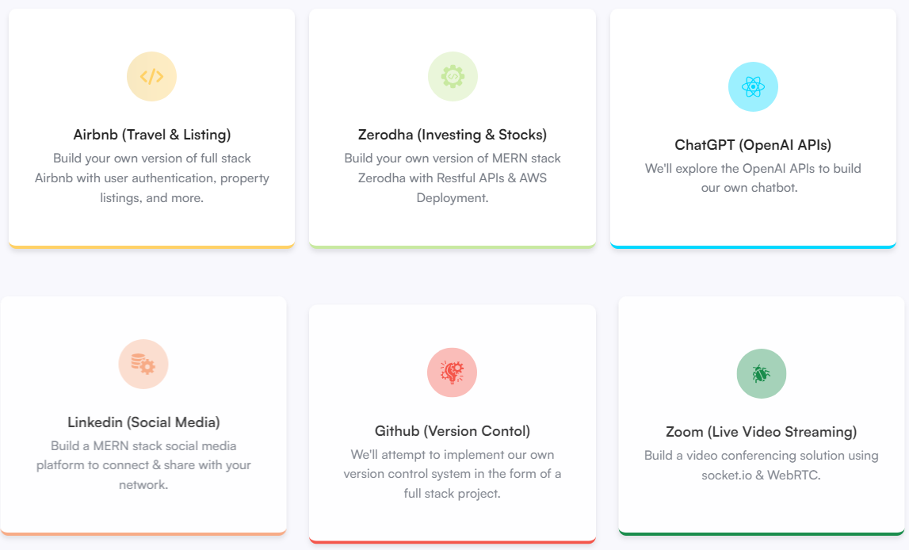

Slide 9
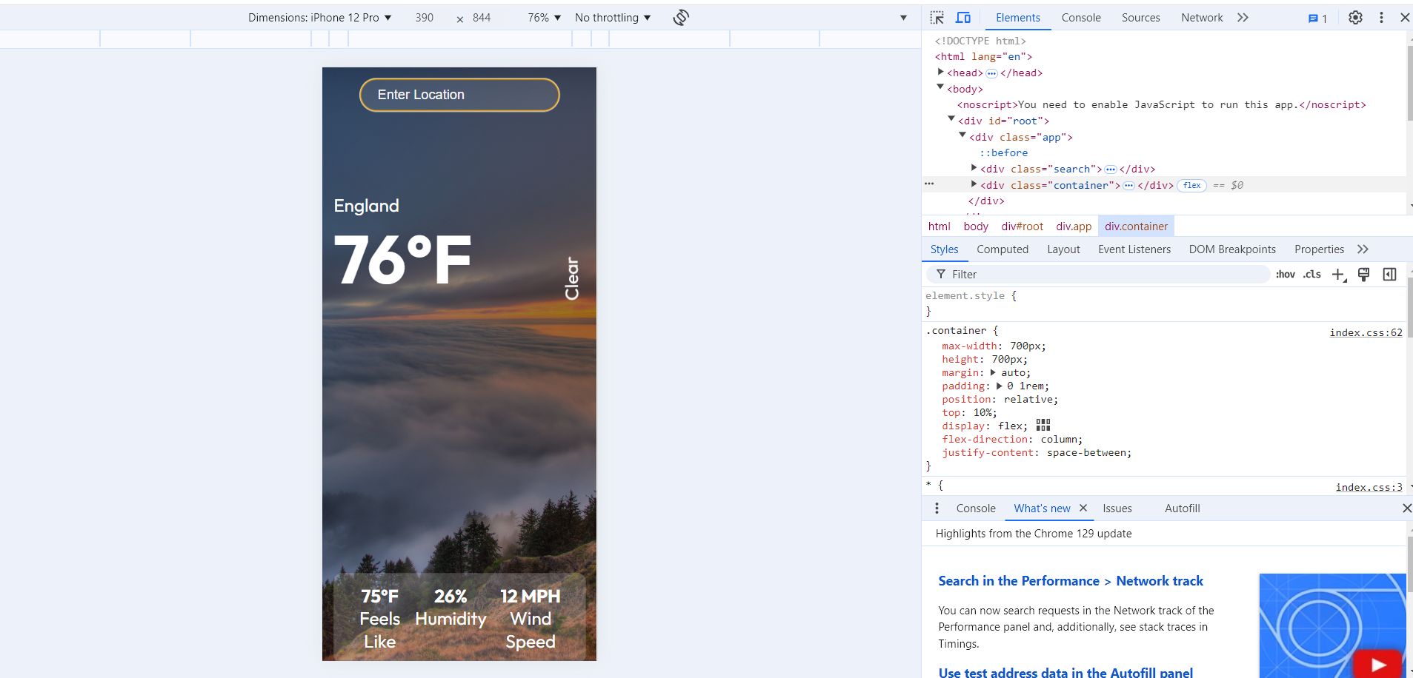
Hands-On Mini Project
code:
https://github.com/fireclint/weather-app-react
Explanation:
https://youtu.be/UjeXpct3p7M?si=QWSbfjirsfg5MdHw
Note:
Install nodeJS:
https://youtu.be/06X51c6WHsQ?si=INEyCtycQP8CZINg
cd correct file name
npm install
npm start

Slide 10
Final tips & Resources
Project Demo
Flask
Django
React
Road Map
For all roles road map
https://github.com/kamranahmedse/developer-roadmap?tab=readme-ov-file
Problem as per company wise
https://www.propeers.in/roadmaps
ASP.NET Core Developer Roadmap
https://github.com/MoienTajik/AspNetCore-Developer-Roadmap?tab=readme-ov-file
Courses
Python Technology Stack
JAVA Technology Stack
Angular Full Stack
https://infyspringboard.onwingspan.com/web/en/page/lex_auth_01398268320967884838

Slide 11

Thank you
Sunita Shakuniya
Final year CSE-B
shakuniyasunita6@gmail.com
https://www.linkedin.com/in/sunitashakuniya/
https://github.com/Sunita-Shakuniya

